Slide 1
Practice #2
Create Performance Task

Slide 2
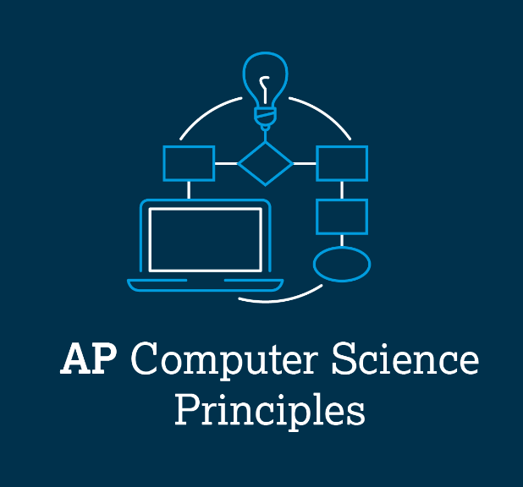
AP CSP Create Performance Task
Part of the AP Exam is to create a program that meets specific requirements:
Creates a list
Uses a list in a meaningful way
Has a function with a parameter
  Parameter affects function execution
Function has:
  If statement
  Loop

Slide 3
AP CSP Create Performance Task
Things to know about the Create PT:
You can work with a partner
Your classmates can help you
Your teacher cannot help you
You cannot use an assigned program for your project, but it can be similar
You will be given 9 hours of class time to work on the project

Slide 4
AP CSP Create Performance Task
The Create PT is like a remix project:
Start small and add components.
Start with what you know.
Don’t try something new that you don’t know how to do.
This isn’t a time to learn something new, but to show what you know how to do.

Slide 5
AP CSP Create Performance Task
The Create PT is like a remix project:
During a remix, you looked at completed programs and reviewed what you learned.
You either added to or created a program similar to your completed programs.
You can do the same thing for the Create PT.
Let’s look at a program from a mission and remix it to meet the requirements of the Create PT.

Slide 6
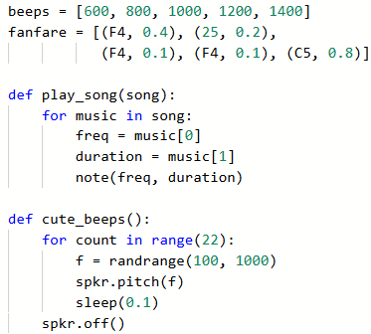
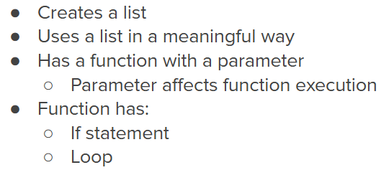
Practice #2
In CodeSpace, go to the Sandbox.
Open the project: WhatIf_loops
Go to File Save As… and rename the file PT_CodeBot_Practice2
Review the code.
What PT requirements does it meet?
What PT requirements does it lack?

Slide 7


Practice #2
PT Requirements
Creates a list
Uses a list in a meaningful way
Has a function with a parameter
  Parameter affects function execution
Function has:
  If statement
  Loop

Slide 8
Practice #2
This project meets most of the requirements.
It won’t take much work to meet all of the requirements.
You can meet the requirements in several different ways.
Go to the Activity Guide and write down some possible program modifications.

Slide 9
Practice #2
During this lesson you will add two ways to meet the requirements.
One way to meet this Create PT requirements is to add a parameter and if statement to cute_beeps().
Right now it is only called when the ‘bot is spinning.
The function could also be called while going straight, using different beeps.

Slide 10
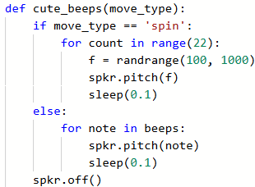
Practice #2
Here is an example of adding a parameter and if statement to cute_beeps().
The parameter can be an integer or a string.
The second branch can use the speaker in any way.
Original code
Second branch

Slide 11
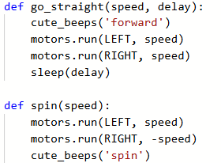

Practice #2
Here is an example of function calls:

Slide 12
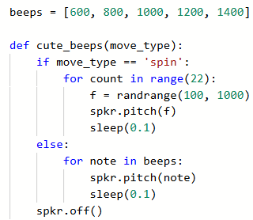

Practice #2
Revisit the PT Requirements:
Creates a list
Uses a list in a meaningful way
Has a function with a parameter
  Parameter affects function execution
Function has:
  If statement
  Loop

Slide 13
Practice #2
Another way you can meet the Create PT requirements is to add a second fanfare list and use in play_song().
Mission 4 Objective 12 gives you the frequencies of two notes.
Here are some more notes, starting with middle C:
C4 | D4 | E4 | F4 | G4 | A4 | B4 | C5 | D5 | E5 | F5
262 | 294 | 330 | 349 | 392 | 440 | 494 | 523 | 587 | 659 | 698

Slide 14
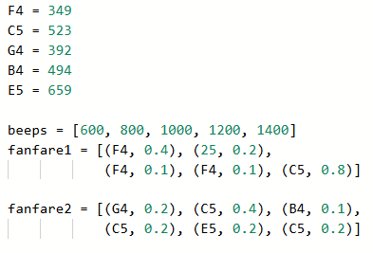
Practice #2
Add another list for a different fanfare.
It can be a real tune, or just some notes that sound good:

Slide 15
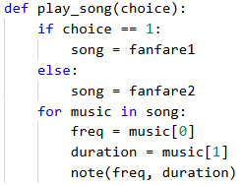
Practice #2
Add another list for a different fanfare.
Change the parameter to a choice, instead of the song.
Use an if statement to select the song.
You don’t have to change the for loop at all!

Slide 16

Practice #2
Change the function call.
One way to add some whimsy to the program is to randomly select which fanfare to play.

Slide 17
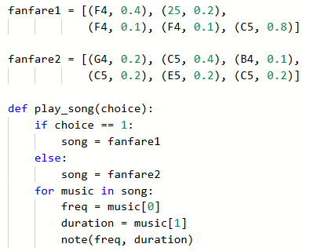
Practice #2
Revisit the PT Requirements:
Creates a list
Uses a list in a meaningful way
Has a function with a parameter
  Parameter affects function execution
Function has:
  If statement
  Loop

Slide 18
Practice #2
The requirements are met!
This lesson showed two ways to meet the Create PT requirements.
If you were using this as your project, which one way would you use?
You could do both modifications, but you will only need to discuss one of the functions and one of the lists.
Go to the activity guide and answer the questions about Practice #2.

Slide 19
Practice #2
Now that you have seen two examples of modifying the SweepLEDs program, can you think of any other ways to remix the project for the Create PT?
Go to the Activity Guide and write down any more ideas you have for modifications.

Slide 20
Practice #2
Final considerations.
Your program needs to have input and output.
  Be prepared to explain the input and output of this program?
If you create a program similar to this for the Create PT, be prepared to state the purpose and intended users.
  Note: the purpose is the WHY it was created.
  The WHY is the reason it is created, or the problem it solves. For this program, the purpose could be automation in the entertainment industry.
  WHAT is the function. In this program, the program’s function is to count guests and then perform an animation.

